Slide 1
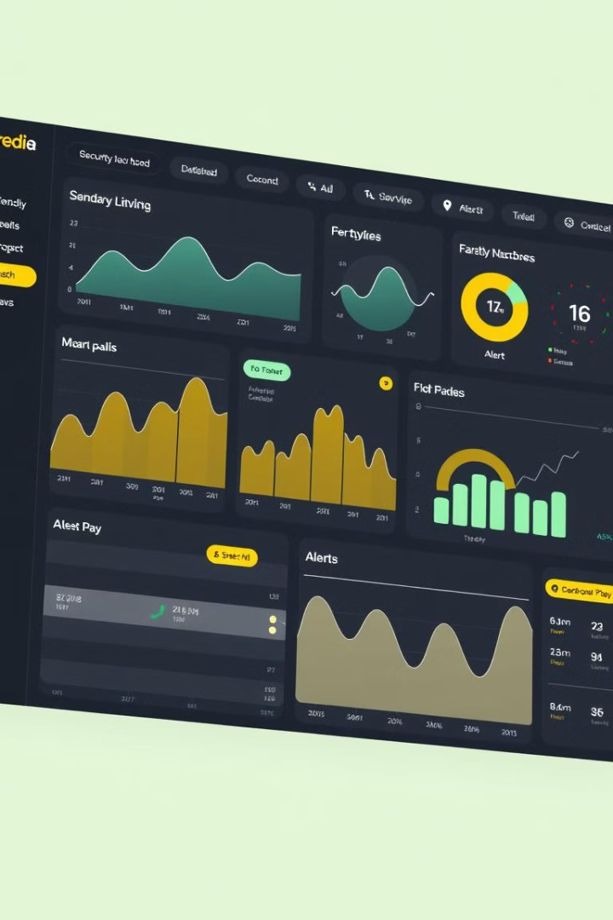

API Logging and Monitoring for Security Events
Robust API logging and monitoring are essential for detecting and responding to security threats in real-time. By tracking key API metrics and leveraging advanced analytics, organizations can proactively safeguard their systems and data.
by cse c

Slide 2

Importance of API Security
1
Protect Sensitive Data
2
Prevent Attacks
3
Ensure Regulatory Compliance
APIs can be targeted by various security threats, including injection attacks, authentication vulnerabilities, and DDoS.
APIs provide access to critical business information, which must be secured against unauthorized access and misuse.
Effective API security is often required to meet industry regulations and data privacy standards.

Slide 3
Common API Security Threats
Injection Attacks
Authentication Vulnerabilities
DDoS Attacks
Attackers inject malicious code into API requests to gain unauthorized access or disrupt system functionality.
Overwhelming APIs with excessive traffic can cause service disruptions and denial of service.
Weak or improper authentication mechanisms can allow attackers to impersonate legitimate users.

Slide 4
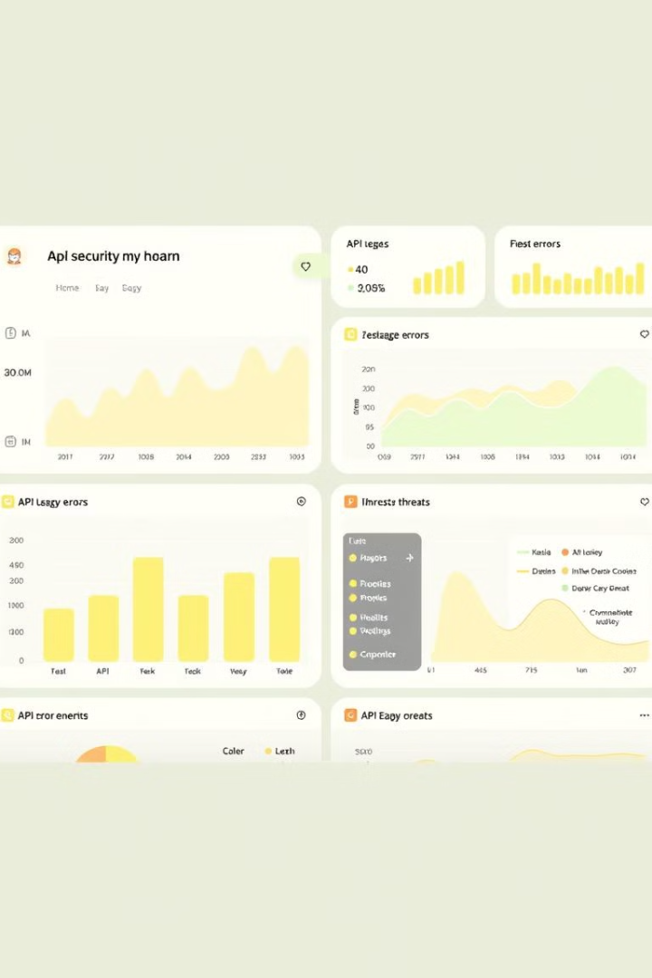
Benefits of API Logging and Monitoring
Threat Detection
Compliance Reporting
Identify suspicious activities and potential security breaches in real-time.
Generate detailed audit trails to demonstrate adherence to regulatory requirements.
Performance Optimization
Incident Response
Leverage logging and monitoring data to quickly investigate and respond to security incidents.
Analyze API usage patterns to identify bottlenecks and improve overall system efficiency.

Slide 5
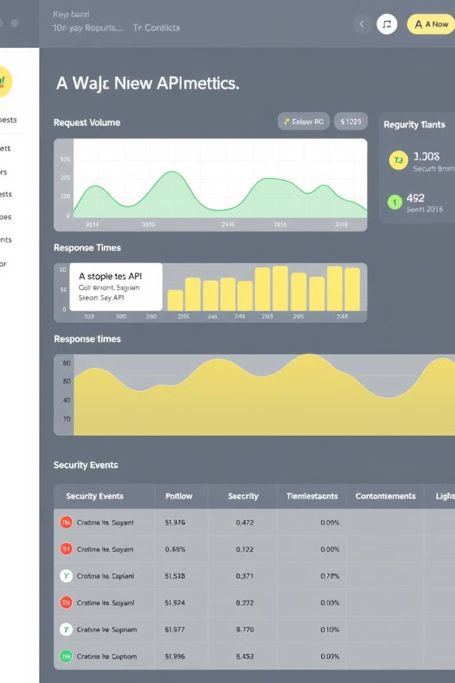




Key Metrics to Track
Request Volume
Error Rates
Monitor overall API usage and identify anomalies.
Detect potential vulnerabilities or system issues.
Response Times
Security Events
Ensure APIs are performing within expected thresholds.
Identify and investigate potential security threats.

Slide 6




Selecting the Right Logging and Monitoring Solution
Comprehensive Visibility
Ensure the solution provides detailed insights into API traffic, errors, and security events.
Real-Time Alerting
Enable fast detection and response to potential security incidents.
Scalable Infrastructure
Support high transaction volumes and handle growing data requirements.

Slide 7

Implementing Effective Logging Practices
1
Determine Logging Requirements
Identify the critical information needed to support security monitoring and compliance.
2
Centralize Log Collection
Aggregate logs from all API endpoints into a unified repository for analysis.
3
Establish Retention Policies
Ensure logs are stored for sufficient duration to meet regulatory and investigative needs.

Slide 8
Leveraging Monitoring for Threat Detection
Behavioral Analytics
Correlation and Alerting
Threat Hunting
Identify anomalies in API usage patterns that could signal potential security breaches.
Combine multiple data sources to detect and alert on complex security threats.
Proactively search for indicators of compromise and uncover hidden security risks.

Slide 9

Integrating with Incident Response Workflows
1
Rapid Investigation
Leverage logging and monitoring data to quickly identify the scope and impact of incidents.
2
Containment and Mitigation
Use API-specific insights to implement targeted security controls and mitigate threats.
3
Comprehensive Reporting
Generate detailed incident reports to support root cause analysis and regulatory compliance.

Slide 10

Conclusion and Next Steps
1
Holistic Security Approach
2
Continuous Improvement
3
Leverage Automation
Automate security workflows to improve efficiency and reduce the risk of human error.
Integrate API logging and monitoring into a broader cybersecurity strategy.
Regularly review and refine logging and monitoring practices to address evolving threats.

